Slide 1
2025 Oil Market Outlook
with Bison Interests
Speakers: Zack Oliva | Co-owner, Oliva Gibbs Josh Young | Founder, Bison Interests

Slide 2
Zack Oliva
Co-owner, Oliva Gibbs
Zack co-founded Oliva Gibbs in 2013. He has worked with upstream operators and oilfield service companies on the drafting and negotiation of contracts, complex title issues, and the purchase and sale of assets across New Mexico, Ohio, and Texas. Additionally, entrepreneurs in the energy industry seek his assistance with business partnership issues.
713.229.0360
zoliva@oglawyers.com
Follow Zack on LinkedIn

Slide 3
Josh Young
Founder, Bison Interests
Josh has been professionally investing in publicly traded oil and gas securities for nearly two decades, achieving benchmark outperformance as Bison's founder and Chief Investment Officer. He began his career as a management consultant and investment analyst for Fortune 500 companies and private equity firms.
832.299.3380
info@bisoninterests.com
Follow Josh on LinkedIn

Slide 4
Disclaimer
The Presentation does not constitute an offer to sell, or a solicitation of an offer to purchase, any securities. Any such offer or solicitation will be made in accordance with applicable securities laws.
The Presentation is being provided on a confidential basis solely to those persons to whom this Presentation may be lawfully provided. It is not to be reproduced or distributed to any other persons (other than professional advisors of the persons receiving these materials). It is intended solely for the use of the persons to whom it has been delivered and may not be used for any other purpose. Any reproduction of the Presentation in whole or in part, or the disclosure of its contents, without the express prior consent of Bison Interests, LLC (the “Company”) is prohibited.
No representation or warranty (express or implied) is made or can be given with respect to the accuracy or completeness of the information in the Presentation. Certain information in the Presentation constitute “forward-looking statements” about potential future results. Those results may not be achieved, due to implementation lag, other timing factors, portfolio management decision-making, economic or market conditions or other unanticipated factors. Nothing contained herein shall be relied upon as a promise or representation whether as to past or future performance or otherwise. The views, opinions, and assumptions expressed in this presentation are as of March 2025, are subject to change without notice, may not come to pass and do not represent a recommendation or offer of any particular security, strategy or investment.
The Presentation does not purport to contain all of the information that may be required to evaluate the matters discussed therein. It is not intended to be a risk disclosure document. Further, the Presentation is not intended to provide recommendations, and should not be relied upon for tax, accounting, legal or business advice. The persons to whom this document has been delivered are encouraged to ask questions of and receive answers from the general partner of the Company and to obtain any additional information they deem necessary concerning the matters described herein. None of the information contained herein has been filed or will be filed with the Securities and Exchange Commission, any regulator under any state securities laws or any other governmental or self-regulatory authority. No governmental authority has passed or will pass on the merits of this offering or the adequacy of this document. Any representation to the contrary is unlawful.
Bison Interests, LLC may hold positions in the companies mentioned here and may hold other positions not listed here. It reserves the right to buy or sell those or any other stock at any time without further notification.
Performance is from stated period (earliest May 2015, Bison inception) to March 2025. These performance measures are illustrative and may not be indicative of actual or average performance achieved by clients.

Slide 5
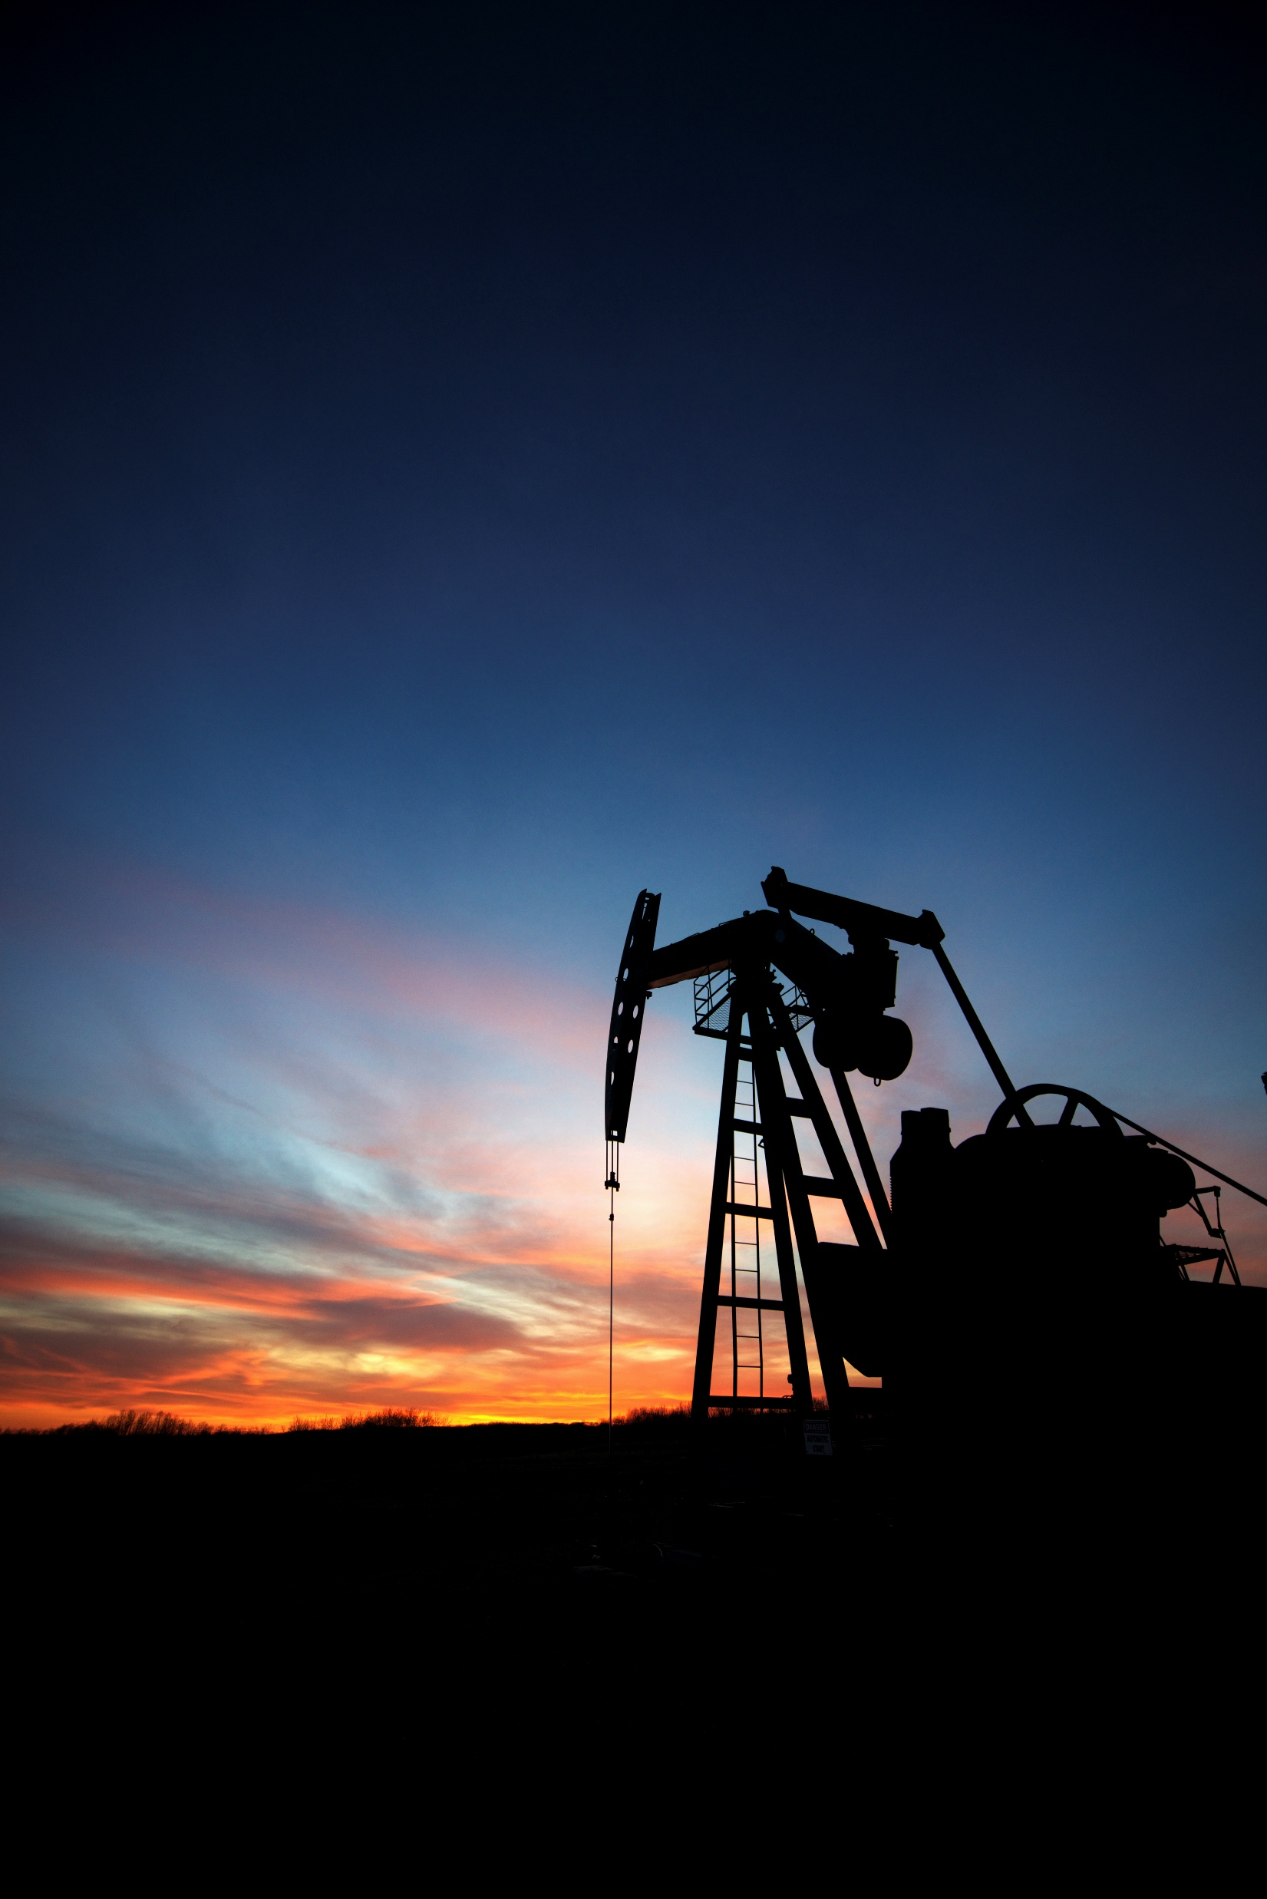
Agenda
01
02
OIL MARKET OVERVIEW Low rig counts and producer capex guidance indicate that higher oil prices are needed to incentivize the production growth required to meet rising demand.
NATURAL GAS MARKET OVERVIEW LNG facilities and AI data centers will drive significant gas demand through 2030. Current underinvestment by producers is likely to raise prices, benefitting producers and service companies.
03
04
OPPORTUNITY IN OIL & GAS EQUITIES Oil and gas equities have lagged other indices over the past two years and now offer compelling value opportunities.
Q&A Your questions, answered.

Slide 6
U.S. Shale’s Slowing Growth
U.S. shale drove global supply growth over the past decade, adding ~8 million barrels/day to production.
U.S. production growth is now slowing due to depleting core inventories, reduced drilling activity, and capital discipline.
U.S. shale production growth has supported global oil markets over the past decade. Depleting core U.S. inventory is leading to an expected slowdown in U.S. production growth.
Non-OPEC supply is not expected to meet global demand growth, leaving room for OPEC barrels and shifting market leverage to the group, who can withhold barrels from the market to drive up oil prices.

Slide 7
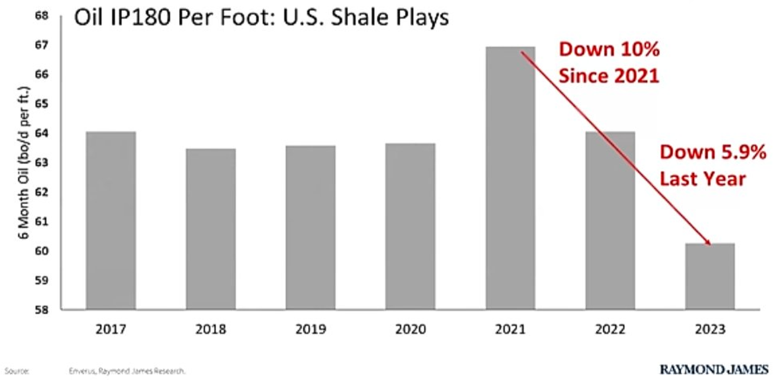
U.S. vs. Global Oil & Liquids Production (2014–2024)
U.S. Shale Oil Production Per Foot (2017 – 2023)
EIA Forecast: Slowing U.S. Oil Production Growth (2023–2026E)
U.S. shale has supported global oil markets…
US Production, MB/D
Rest of World Production, MB/D
Annual US Production Growth, MB/D
US Supply
…but U.S. production growth is now expected to slow.
Rest of World
Sources: EIA, Raymond James
2023
2024
2025E
2026E

Slide 8
Producers Cutting Capex Despite “Drill Baby, Drill”
Producers are cutting capital expenditures for next year; prioritizing shareholder returns over aggressive drilling.
Public E&Ps are focused on dividends and buybacks, not production growth.
Prices do not appear high enough to spur additional drilling activity in the U.S.

Slide 9
Major Producers Announce
2025 Capex Cuts
U.S. Oil Rig Count (2023–Feb. 2025)
Weekly U.S. Oil Rig Count
Producers are reducing investment in new well drilling.
Sources: Reuters, ChemAnalyst, S&P Global, Baker Hughes
2023
2024
2025

Slide 10
Rising Demand vs. Low Inventories
Oil demand is expected to grow by another ~1% in 2025, driven by India, China, and other emerging economies.
Tight oil inventories leave the market vulnerable to supply shocks and increase price volatility.
Recent underinvestment inn oil production, coupled with rising demand and near two-decade low inventories, suggests a tightening market.

Slide 11
Global Oil & Petroleum Liquids Demand Growth (1970–2030E)
U.S. Stocks of Crude Oil & Petroleum Products (2015–2025)
Million Barrels Per Day
Long-term 1% growth trend
Low inventories
1970
1980
1990
2000
2010
2020
2030E
2015
2016
2017
2018
2019
2020
2021
2022
2023
2024
2025
Sources: EIA, International Energy Forum

Slide 12
OPEC Supply Needed to Balance the Market in 2025
Assuming non-OPEC production grows at last year’s rate, EIAA projections indicate room for an additional one million barrels of OPEC supply, explaining OPEC’s decision to unwind cuts.

Slide 13
The Oil Market Balance: Call on OPEC in 2025 Explains Decision to Unwind Cuts
Million Barrels Per Day
Global Demand
Global Production
Non-OPEC Production Growth
OPEC Cuts
Call on OPEC
With oil prices $15 lower than last year, similar non-OPEC production growth seems overstated, but rising demand still supports a 1 mbd OPEC supply increase.
-0.2
2023 Demand
2023 Production
Non-OPEC Growth
OPEC Cuts
2024 Production
2025E Non-OPEC Growth
2025E Call on OPEC
2025E Production
2025E Demand¹
1. Includes a 0.4 mbd upward adjustment, consistent with the revision for December 2024.
Source: EIA February 2025 STEO Historical Data and Projections

Slide 14
OPEC Needs Higher Prices
OPEC has recently cut production at prices as high as $85 WTI, indicating the group desires much higher prices than current levels.
Saudi Arabia, OPEC’s largest member, requires an oil price of $96/bbl to balance its budget, according to the IMF.
The kingdom is spending large amounts to transform its economy, underscoring the need for higher prices.
Key OPEC members require higher oil prices to support their economic growth plans. The group’s decision to unwind production cuts at this time signals confidence in a tightening oil market balance.

Slide 15
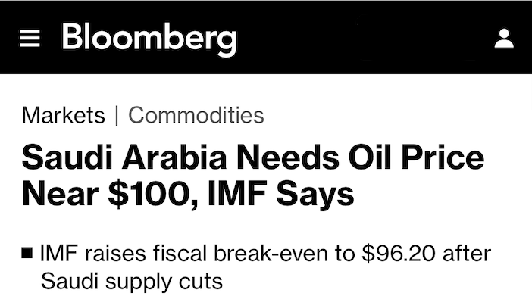
Headlines
OPEC Production Cuts vs. WTI Price (2022–Mar. 2025)
OPEC Desired Price: > $85
OPEC announces 2.2 mbd cut
WTI, $/BBL
OPEC announces 2 mbd cut
OPEC announces 1.66 mbd cut
OPEC extends 2.2 mbd cuts
$120
OPEC extends 2.2 mbd cut
$100
$80
$60
2022
2023
2024
2025
Sources: Bloomberg, EIA WTI Prices, OPEC

Slide 16
Low Prices > Buying Opportunity
Low rig counts, reduced 2025 capex, and OPEC cuts suggest we’re near the price cycle bottom, where oil equities have historically subsequently outperformed.

Slide 17
Oil Price Cycle
2
High Prices
High prices make production highly profitable, leading to an increased investment and elevated E&P valuations.
Elevated prices dampen demand as consumer look for alternatives.
Increased supply and slowed demand growth begin to put downward pressure on prices.
1
Rising Prices
3
Falling Prices
With supply tightening and demand rising, prices start to increase, making production more profitable.
Higher prices attract new investment in exploration and production, gradually increasing supply.
E&P equity valuations begin to rise.
Oversupply from previous investments and reduced demand start to drive prices down.
As prices drop, companies begin scaling back on new investments, reducing future supply growth.
Oil and gas equity valuations are falling in this environment.
4
Low Prices
Low prices reduce investment and depress E&P equity valuations.
Lower prices make oil more attractive, stimulating demand growth.
As demand grows and supply shrinks due to reduced investment, upward pressure on prices begins.

Slide 18
Agenda
01
02
OIL MARKET OVERVIEW Low rig counts and producer capex guidance indicate that higher oil prices are needed to incentivize the production growth required to meet rising demand.
NATURAL GAS MARKET OVERVIEW LNG facilities and AI data centers will drive significant gas demand through 2030. Current underinvestment by producers is likely to raise prices, benefitting producers and service companies.
03
04
OPPORTUNITY IN OIL & GAS EQUITIES Oil and gas equities have lagged other indices over the past two years and now offer compelling value opportunities.
Q&A Your questions, answered.

Slide 19
U.S. Natural Gas Market
Overview
Demand growth will be driven by large buildouts of LNG facilities for export as well as increased power demand from AI data centers.
Production has been flat to lower year over year as producers are underinvesting due to low gas prices throughout 2024.
It took a decade of shale growth to add 30 Bcf/d of U.S. natural gas supply, but we expect demand to grow by that same amount in just the next five years while production has stalled.

Slide 20
U.S. Natural Gas Production & Consumption, 2015 – 2030E¹
U.S. Natural Gas Production, 2022-2024
BCF/d
Dry Gas Production, BCF/d
Low prices have led to underinvestment and flat to lower year over year production.
Consumption
2030 Expected Demand: 130 BCF/d+
Production
Bison’s Demand Projection
It took a decade of shale-driven growth to add ~30 BCF/d of production. Now, demand could rise by nearly that amount in just the next 5 years.
2024 Consumption: 103 BCF/D
2024 Production: 103 BCF/D
2015
2018
2021
2024
2027E
2030E
2022
2023
2024
Dec-24
1. Demand is expected to rise 3 Bcf/d annually through 2026 according to EIA estimates, and we expect another 3-6 Bcf/d per year through 2029, driven by LNG exports and AI growth. Sources: EIA, U.S. Department of Energy Planned LNG Projects Report

Slide 21
LNG: The Key Driver of Near-Term Demand Growth
LNG facilities consume large volumes of “feed-gas” to produce liquefied natural gas that is transported to higher priced international markets, like Europe and Asia, where gas prices typically average between $10 to $15 per mcf. This highly profitable regional arbitrage creates steady demand for local gas.
Historically, the amount of LNG that the U.S. could export has been constrained by the volume of gas these facilities can handle. This dynamic is changing, as an additional ~10 BCF/d is expected to come online by 2028 if projects currently under construction begin operations as planned.
LNG facilities will be the biggest drive of near-term natural gas demand growth.

Slide 22
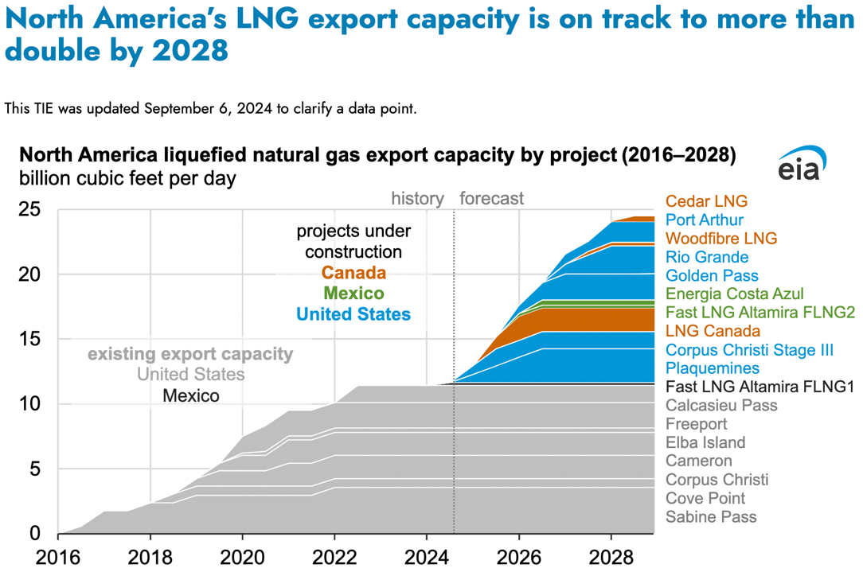
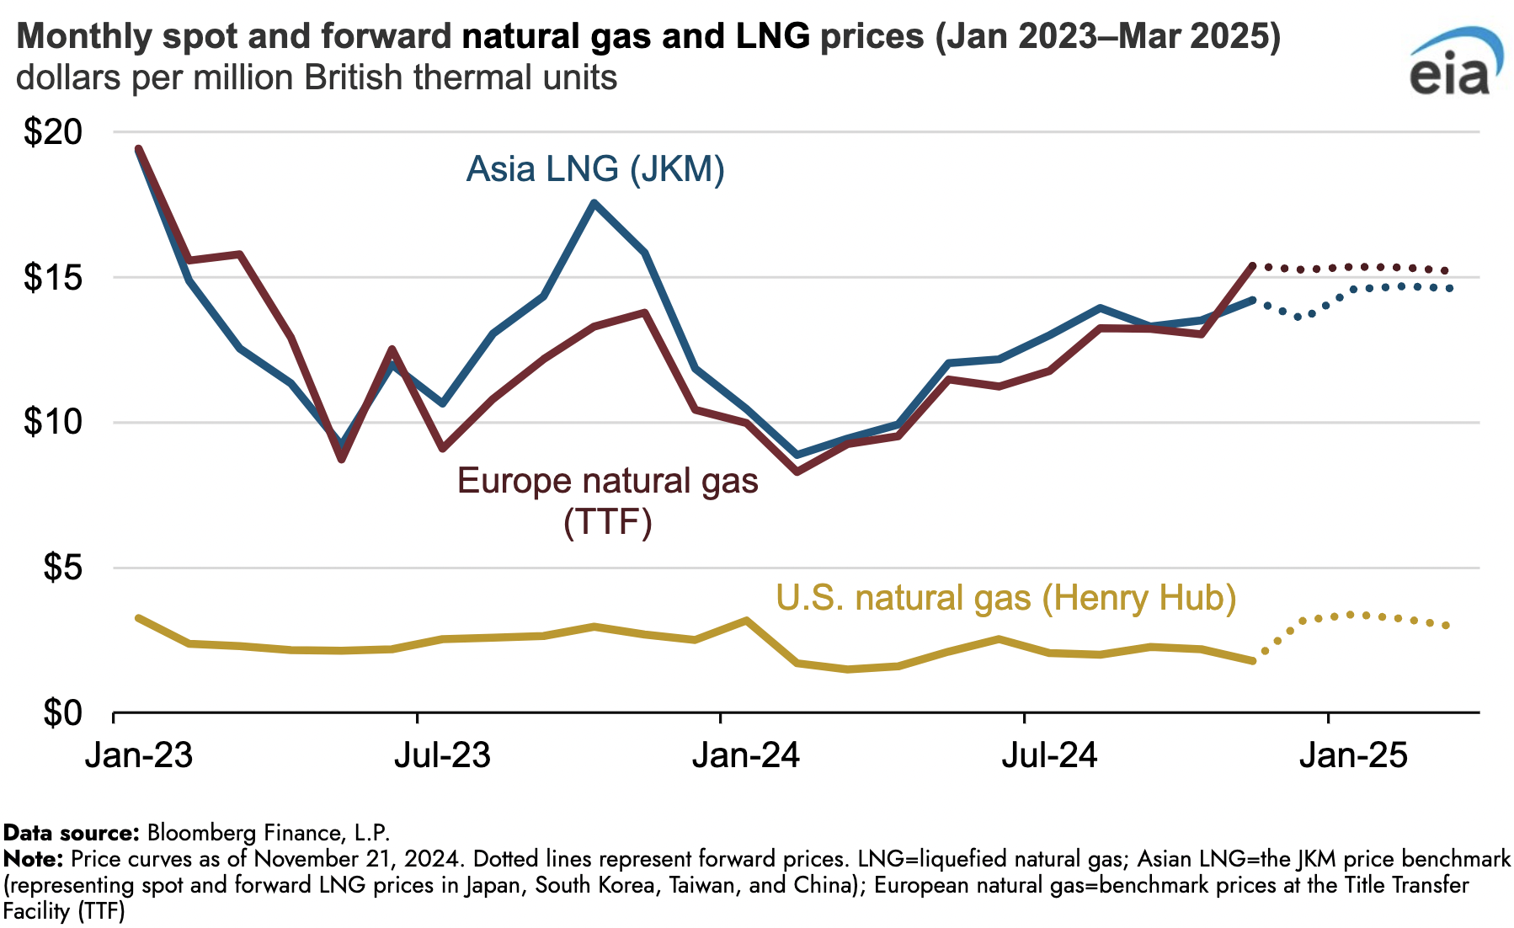
Expected LNG Expansions, 2016–2028E
Arbitrage Opportunity Creates Steady U.S. Demand, 2023–2025E
Source: EIA

Slide 23
Faster LNG Terminal Build Times
LNG facility construction timelines have significantly shortened due to advancements in modular construction designs and improved project efficiencies.
This is a positive development for the 22 Bcf/d of approved LNG export capacity awaiting FID, as it can now be developed more quickly.
The recent example of Corpus Christi LNG Stage 3 and Plaquemines LNG going from FID to operation in just 30 months is bullish for the remaining approved LNG projects.

Slide 24
Potential Additional U.S. LNG Export Capacity (2025–2030E)
LNG Facility Construction Timelines (2014–Present)
US LNG Export Capacity, BCF/d
FID to Operation, in Months
47 bcf
-55%
22 bcf
16 bcf
9 bcf
Current LNG Export Capacity
Additional Projects Under Construction
Approved Projects Waiting FID
Total Potential LNG Export Capacity
Cameron LNG Terminal (2014)
Freeport LNG (2014)
Corpus Christi Stage 1 (2015)
Elba Island LNG (2016)
Sabine Pass LNG, Train 6 (2019)
Calcasieu Pass LNG (2019)
Corpus Christi Stage 3 (2022)
Plaquemines LNG (2022)
Sources: EIA, Global Energy Monitor

Slide 25
AI Data Centers: The Second Driver of Demand Growth
Natural gas has been replacing “dirty” coal as a cleaner alternative, and its reliability makes it superior to wind and solar.
We expect natural gas’ share of U.S. electricity generation to keep growing, alongside a significant increase in total electricity demand driven by AI and continued population growth & grid electrification.
In addition to LNG facility expansion, AI data centers are expected to drive significant growth in natural gas demand for electric power.

Slide 26
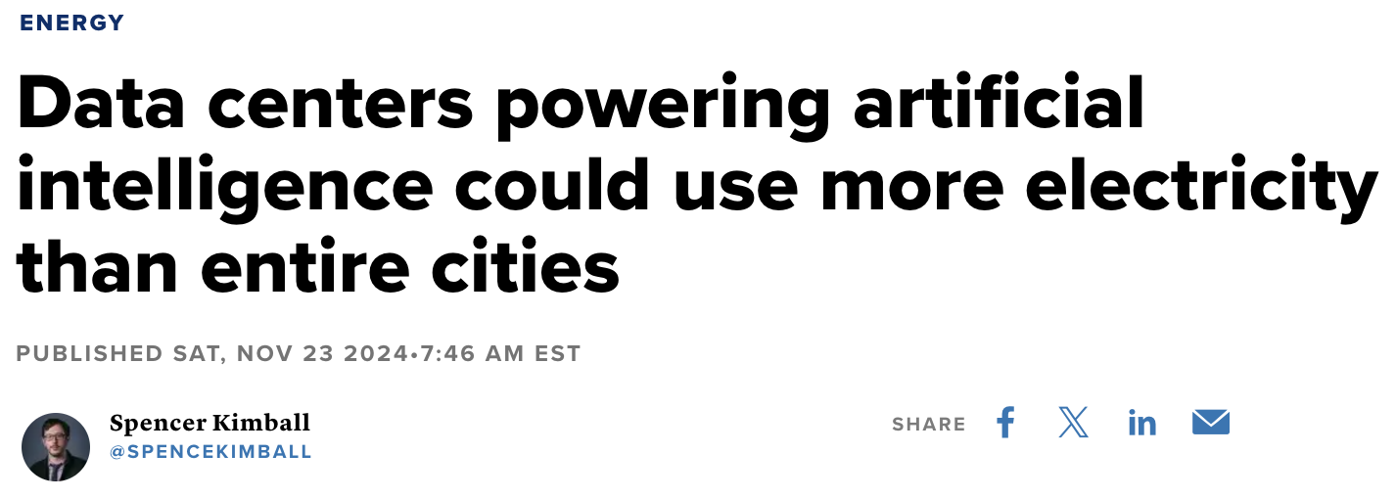
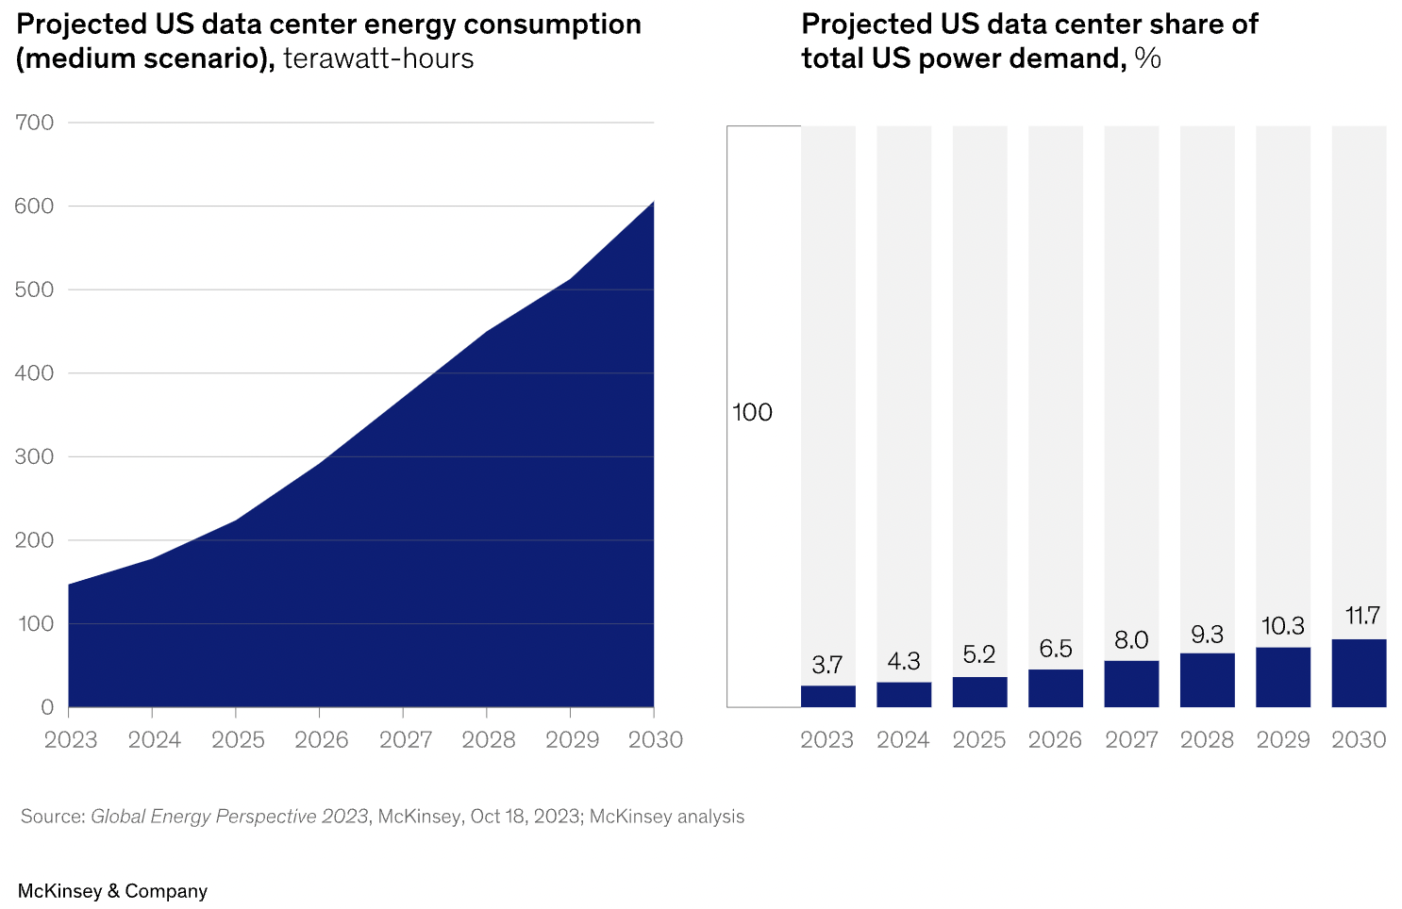
NG Share of U.S. Electricity Generation, 2015–2024
NG Share of U.S. Electricity Generation, 2015–2024
45%
40%
35%
30%
2015
2018
2021
2024
Sources: EIA, CNBC, McKinsey

Slide 27
Stalling Production Due to Lower Rig Counts & Frac Spreads
The key question is how high prices must rise to incentivize producers to resume drilling and increase production ahead of the demand boom.
Even with gas prices at $4.00/mcf and a $4+/mcf forward curve, rig and frac spread counts haven’t risen proportionately, suggesting producers need even higher prices.

Slide 28
U.S. Gas Rig Count, 2022-2025
U.S. Gas Frac Spread Count¹, 2022-2025
2022
2023
2024
2025
2022
2023
2024
2025
1. Gas frac spreads are calculated by multiplying the percentage of total rigs that are gas rigs by the total frac spread count. Sources: EIA, Baker Hughes, as of 2/7/25.

Slide 29
Producers Indicated $5+ Gas Needed for New Investment
Drilled but uncompleted (DUC) well completions have sustained gas production, but as demand accelerates, their depletion will accelerate as well. The current rig count is too low to replace them, but for drilling activity to increase, natural gas prices must rise.
Natural gas producers with strong reserves benefit from higher prices, as higher prices boosts cash flow and increases the value of their reserves. Oilfield service companies will benefit from the pickup in rig activity.
$5 gas would be well above the decade-long average and would generate strong cash flows for gas producers and oilfield service providers.

Slide 30
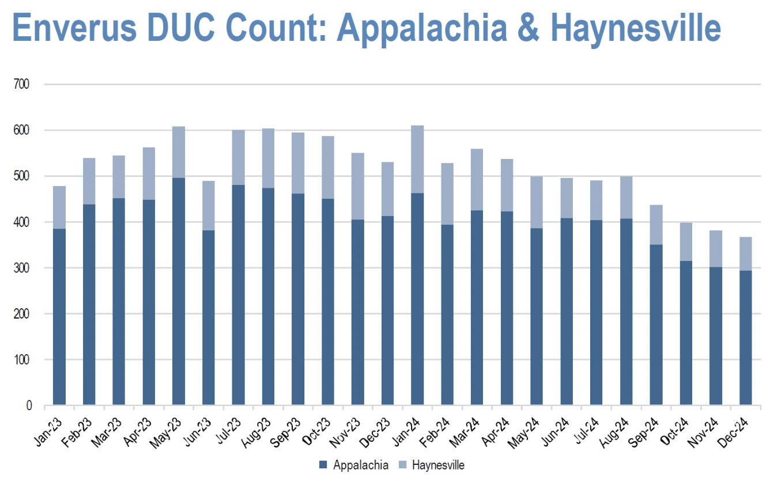
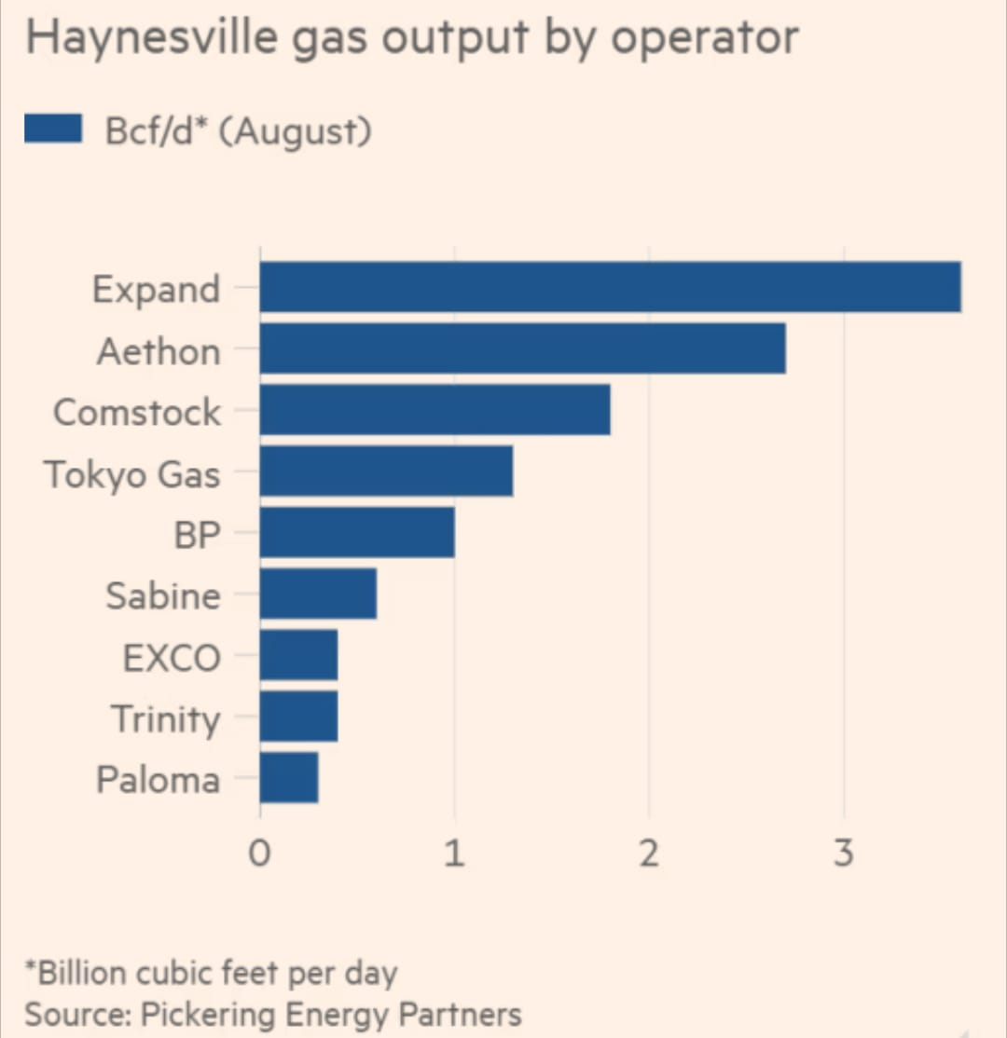
Aethon & Expand Exec. Comments, January 8, 2025
Appalachia & Haynesville DUC Count, 2023–2024
Sources: Hart Energy, Oil & Gas Journal

Slide 31
Agenda
01
02
OIL MARKET OVERVIEW Low rig counts and producer capex guidance indicate that higher oil prices are needed to incentivize the production growth required to meet rising demand.
NATURAL GAS MARKET OVERVIEW LNG facilities and AI data centers will drive significant gas demand through 2030. Current underinvestment by producers is likely to raise prices, benefitting producers and service companies.
03
04
OPPORTUNITY IN OIL & GAS EQUITIES Oil and gas equities have lagged other indices over the past two years and now offer compelling value opportunities.
Q&A Your questions, answered.

Slide 32
Material Upside for Potential Oil Equities
Valuation multiples for oil and gas equities remain historically low compared to previous cycle highs, and there is additional potential upside if they re-rate. Regardless, strong cash flow generation may drive share prices higher.
Upside to small cap and oilfield services equities in “catching up” to large cap peers, as they have in past cycles.
Energy stocks have underperformed the broader market in the last two years. Historically, this has often led to outperformance in subsequent years.

Slide 33
S&P 600 Energy (Total Return), XOP, XLE, WTI & SPY Performance (2023–Feb. 2025)
60%
S&P 600 Energy
XOP
XLE
SPY
SPY: 57%
50%
“Whether we’re talking about socks or stocks, I like buying quality merchandise when it is marked down.”
– Warren Buffett
40%
30%
XLE: 10%
20%
XOP: 8%
10%
0%
-10%
PSCE: -4%
20%
2023
2024
2025
Sources: S&P Global, Investing.com

Slide 34
Capital Outflows Have Depressed Valuations
Small cap energy equities have been particularly discounted, which has hurt short-term mark to market performance but has also created extremely compelling valuation opportunities.
Over four to five years, we expect our investments to generate cumulative free cash flow exceeding their current enterprise value in a flat commodity price environment.
ESG investing trends, low commodity price, and a tech and AI boom have led to capital outflows from the energy sector, leaving many equities deeply undervalued.

Slide 35
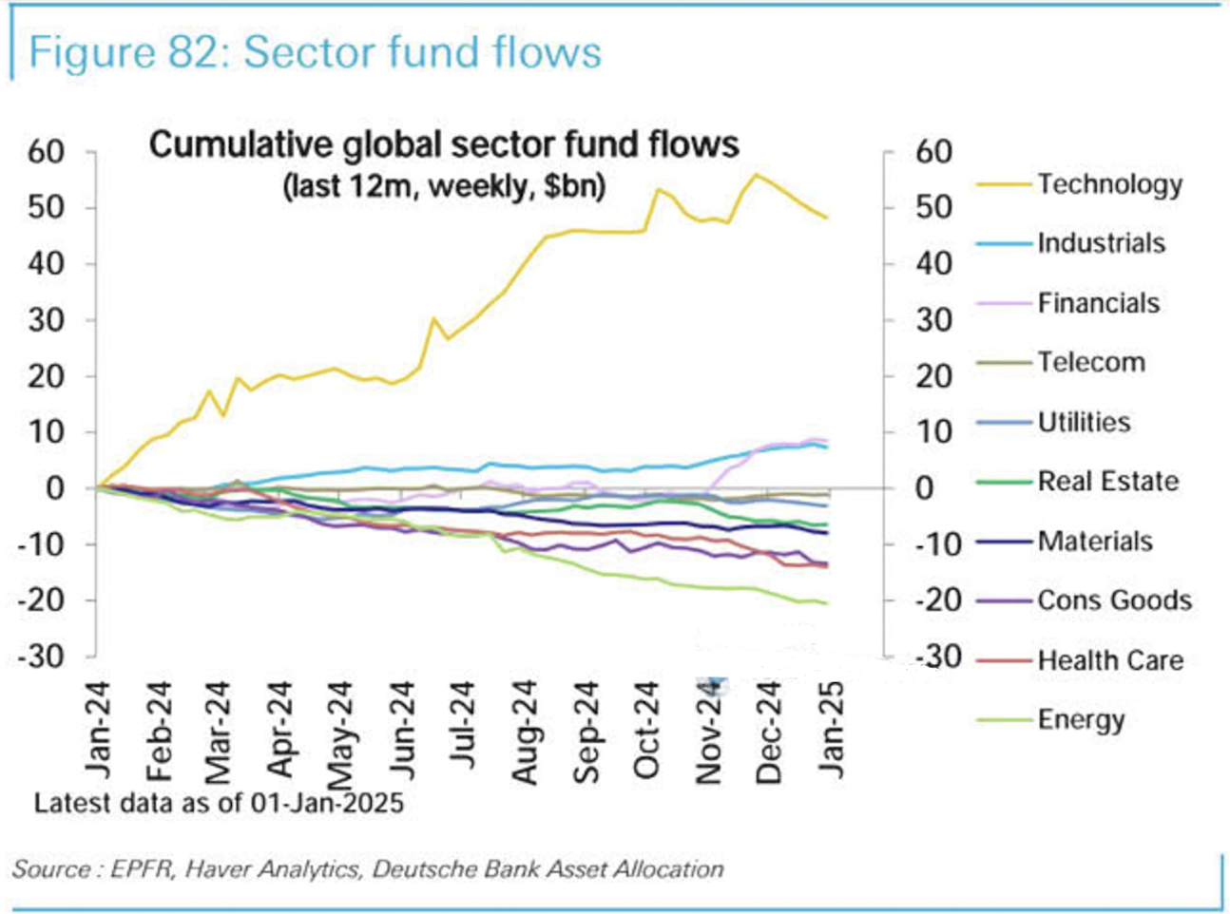
Sector Fund Flows (2024)
Bison Holdings’ 2025E FCF Yield to EV¹
30%
25%
23%
20%
20%
10%
0%
Bison Holding A
Bison Holding B
Bison Holding C
1. Assumes $75 WTI and $3.50 HH. FCF Yields are derived from company guidance and Bison internal analysis. As of 2/21/25.

Slide 36
Thanks for attending!
Sign up for our newsletters and get exclusive access to OG content, top stories about oil & gas, and the latest energy sector news.
Oliva Gibbs LLP
Bison Interests

